Slide 1
Travel Planner StoryBoard
Name: Rabih Sharafalldein

Slide 2
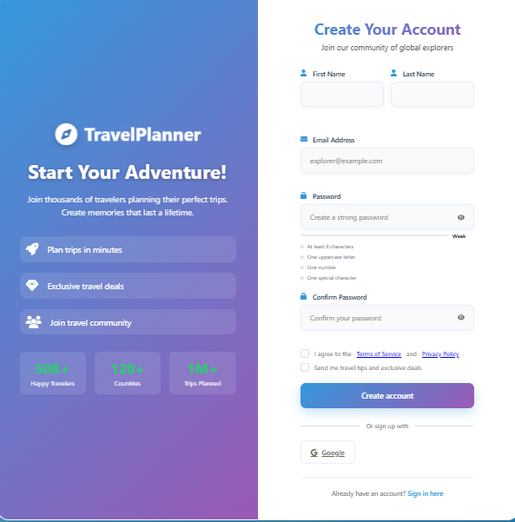
This is the register page the user must enter the following values:
1-First name
2-Last name
3-Email Address
4-Strong Password
4-Confirm his password
5-He can register using his google account

Slide 3
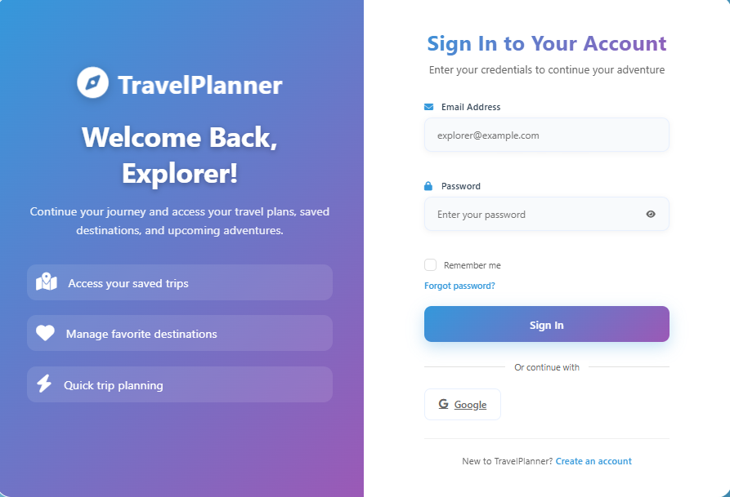
This is the login page, the user must enter the following values:
1-Email Address
2-Password
3-He can login with his google account

Slide 4
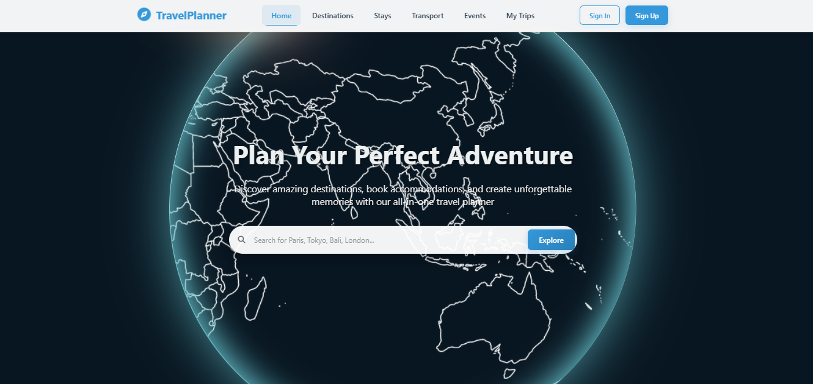
This is the home page the user can:
1-User can sign in or sign up
2-User can enter to the page he want from the dashboard
3-type where he want to go and click explore and it automatically takes him to the destination page with the value he enters

Slide 5
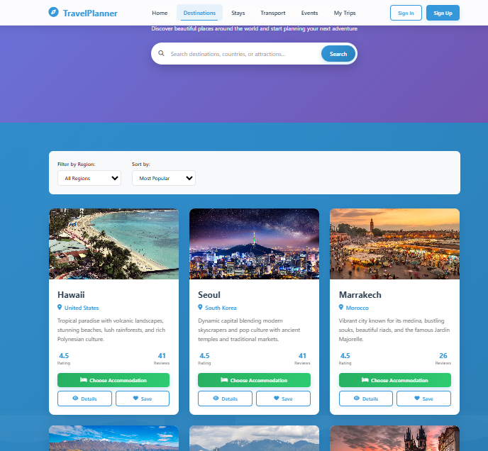
This is the Destinations page, the user can:
1-Type any destination he wants
2-select from the ready made destinations
3-Filter the destinations by region
4-Filter the destinations by rating
5-View destination details
6-Save destination to his whishlist
7-Choose Accommodations based on his destination selection

Slide 6
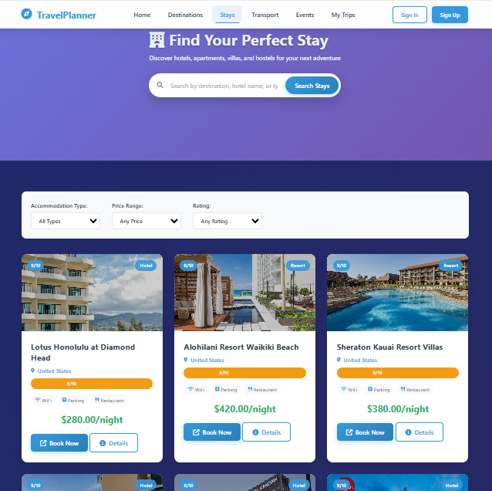
This is the accommodation page, the user can:
1-Search for any hotel in any country
2-Filter the hotels by type, price and rating
3-View hotel details
4-Book the hotel

Slide 7
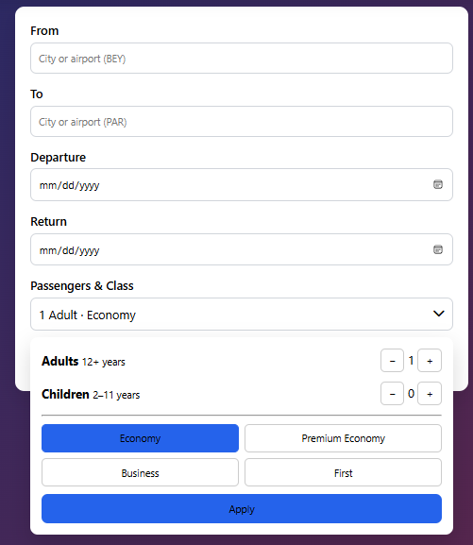
This is the transport page, the user can:
1-Select from which country he is traveling
2-Select to which country he is heading
3-Select the departure time
4-Select the arrival time
5-Select the number of passengers
6-Select the type of class

Slide 8
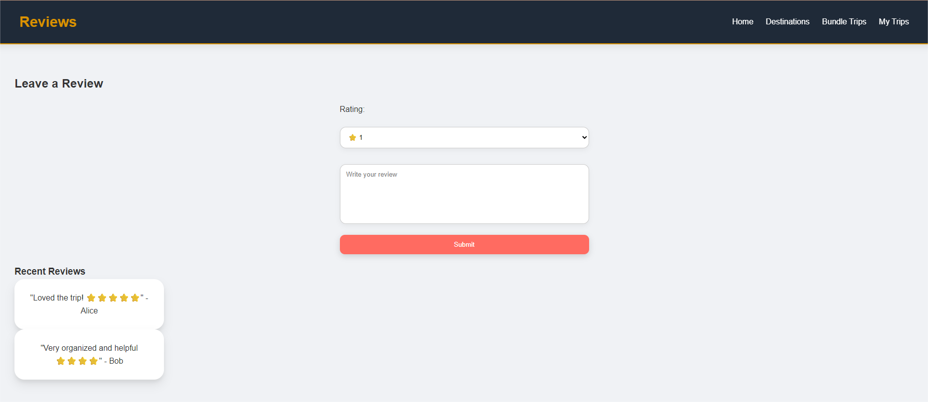
Role: Allows users to submit feedback and view other travelers experiences
Contents : rating form, recent reviews list , filters

